Slide 1


SAP Cloud Integration
Training
ON THE
SAP BUSINESS TECHNOLOGY PLATFORM
Date: Dec 16th, 2022
Time: 9:00AM IST
Facilitator: Anu
www.anubhavtrainings.com

Slide 2
Agenda
Smoke test Basic iflow – hello world
Smoke Test Scenario with External Data Source
Content Modifier

Slide 3
Smoke Test Scenario
This is a very simple test to verify that your SAP Cloud Integration is working as expected. You do not need any receiver system to perform this test.
In this scenario, you create a Hello World text and write it into the message body (scheduled on deployment of the integration flow). The result is written into the message processing log which you can directly inspect with the message monitoring application.

Slide 4
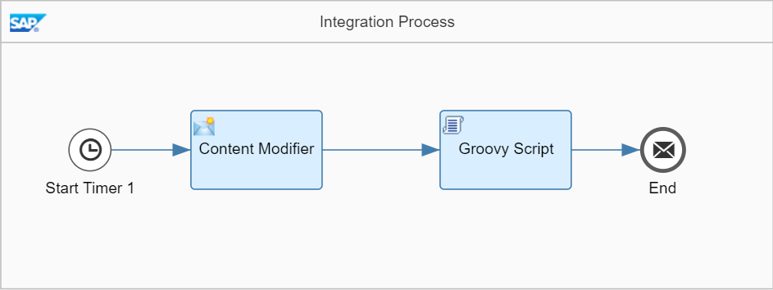

Slide 5
To make it as easy as possible for you to develop this first integration flow, you don't need to configure any sender system. That saves the effort for you to set up a dedicated sender system and to connect it to SAP Cloud Integration. Instead of this, message processing is triggered by a Timer event, and the inbound message payload is created within the integration flow, in a dedicated Content Modifier step.
Furthermore, it is also not required that you set up any receiver system. To enable you to check if the message has been processed correctly, you will configure the integration so that the message payload is written into the message processing log (where you can easily inspect it using the Monitor application of the Web UI).

Slide 6
This is how the integration flow will process the message at runtime:
The Timer event triggers the processing of the message (according to the settings of the Timer's scheduler).
The Content Modifier step creates a message with a simple text content (Hello World!).
The Groovy Script step logs the payload of the message (that means, it writes the message content into the message processing log).
When you have finished the integration flow design, you save and deploy the integration flow.
You can then monitor message processing.

Slide 7
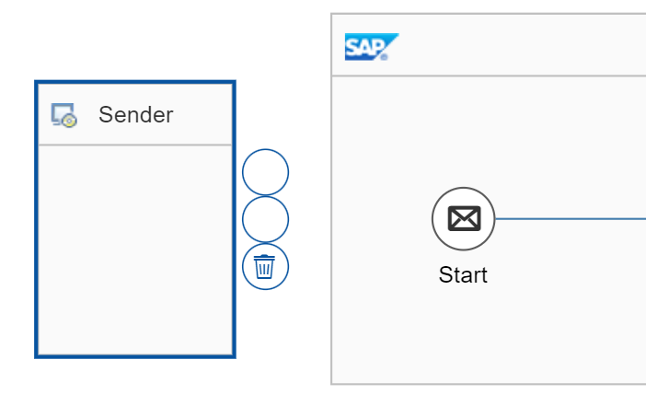
Add a Timer Start Event
Open the integration flow model (Edit mode), select the Sender shape, and choose
the recycle bin icon (to remove the Sender shape

Slide 8
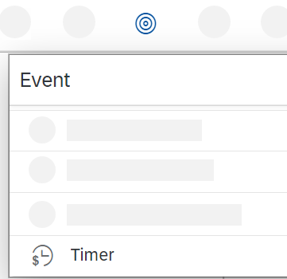
In the same way, remove the Start event.
In the palette, select the Events entry, and then select the Timer shape.

Slide 10
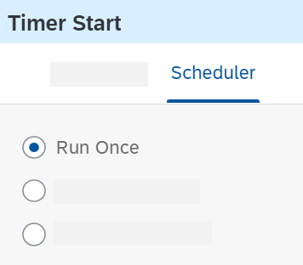
Place the Timer shape in the Integration Process shape (at the point where the Start event was previously located).
In the properties section of the Timer event (displayed below the integration flow model when the Timer event is selected in the model), go to the Scheduler tab.

Slide 11
Make sure that the option Run Once is selected.

Slide 12
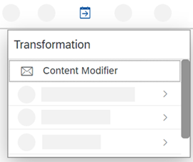
Create a Content Modifier to Define the Message Body
Add a Content Modifier step to create the message body.
As the integration flow has no sender, we use a Content Modifier to create a message from scratch.
To add a Content Modifier, go to the palette, choose the Message Transformers icon, and select the Content Modifier icon.

Slide 13
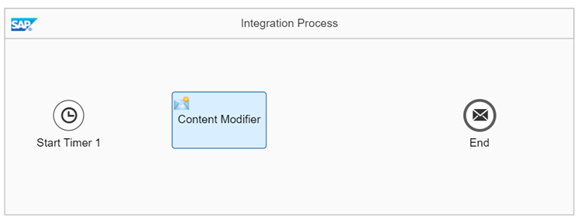
Place the Content Modifier in the model after the Timer Start event.

Slide 14
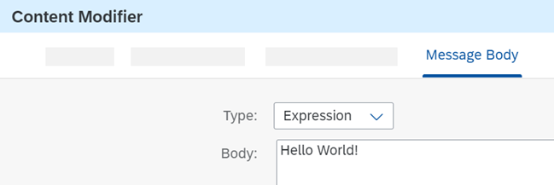
In the Content Modifier properties section, go to the Message Body tab and enter the following string sequence in the entry field:
Hello World!

Slide 15
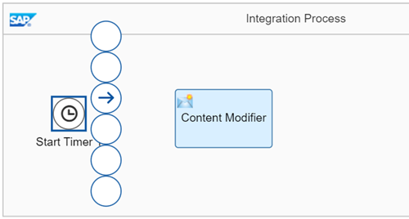
This simulates the inbound XML message.
Connect the Timer event with the Content Modifier. To do this, select the Timer event.

Slide 16
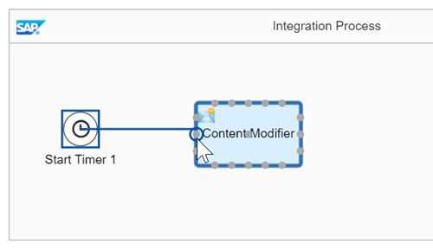
Click the arrow icon, and drag and drop the cursor to the Content Modifier.

Slide 17
Create a Script Step to Log the Payload
Add a Script step to log the message payload.
With a Groovy Script step, you can configure the integration in such a way that the payload of the message is written to the message processing log as attachment.
To add a Script step (containing a Groovy script), go to the palette and choose the Message Transformers icon and select the Script icon.

Slide 18
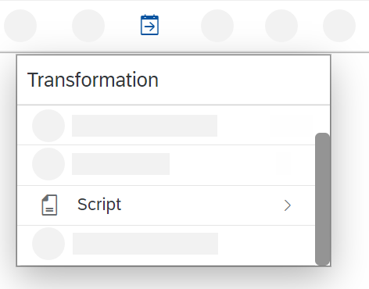

Slide 19
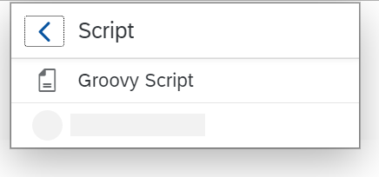
In the Script submenu, select Groovy Script.

Slide 20
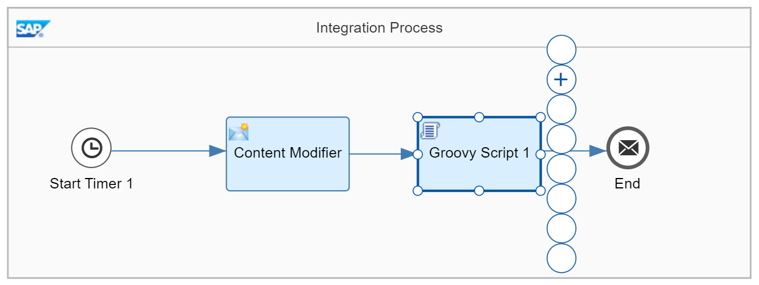
Place the Script step shape after the Content Modifier step and connect both shapes.
Select the Script step.
The context icons are displayed.

Slide 21
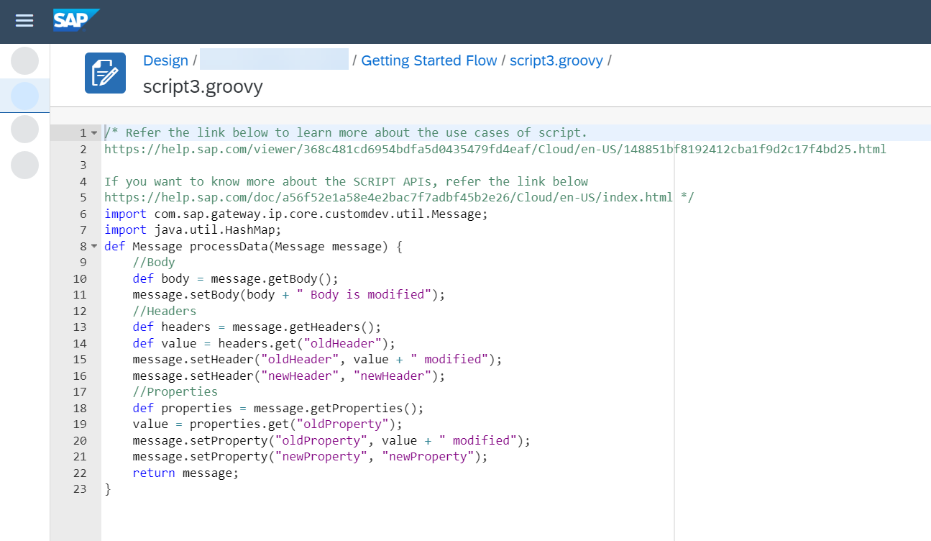
Choose the + icon.
The default script coding of the step is displayed.

Slide 22
Replace this content by the script provided in the coding example below.
import com.sap.gateway.ip.core.customdev.util.Message;
import java.util.HashMap;
def Message processData(Message message)
{
def body = message.getBody(java.lang.String) as String;
def messageLog = messageLogFactory.getMessageLog(message);
if(messageLog != null)
{
messageLog.addAttachmentAsString("Log current Payload:", body, "text/plain");
}
return message;
}

Slide 23
Choose OK.

Slide 24
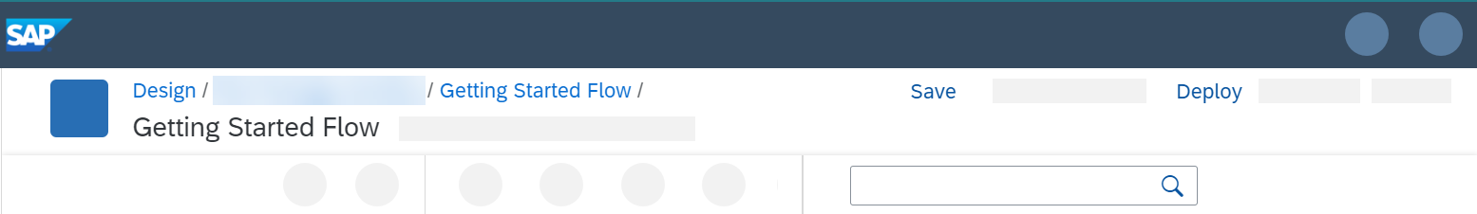
Save and deploy the integration flow on the tenant to process it.
When you've finished modeling the integration flow, select Save.

Slide 25
Once saving has been successful, a corresponding status message is displayed.
Select Deploy.
A message is displayed that asks you to confirm this action.
Select Yes.
Another message is displayed when the validation has been performed and the integration flow deployment has been triggered.
Select OK.
After successful deployment, a status message is displayed.

Slide 26
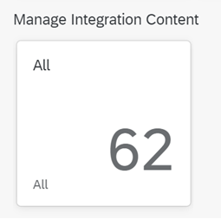
Choose the Operations view to check the status of the deployment.
Select a tile in the section Manage Integration Content.

Slide 27
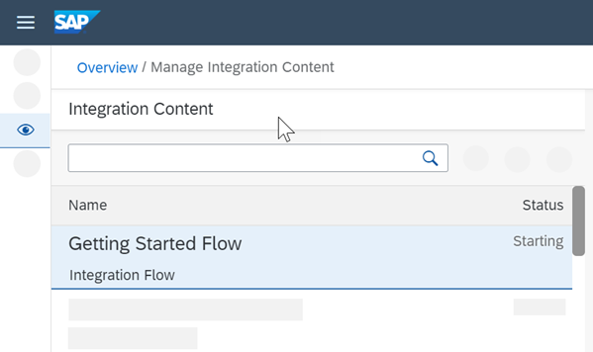
You can check the deployment status of your integration flow. You can check the deployment status of your integration flow.

Slide 28
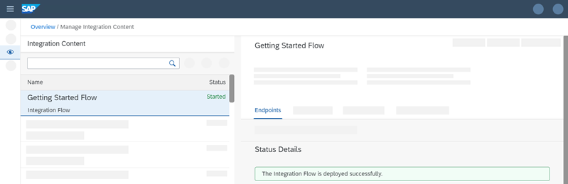
It changes from Starting to Started.

Slide 29
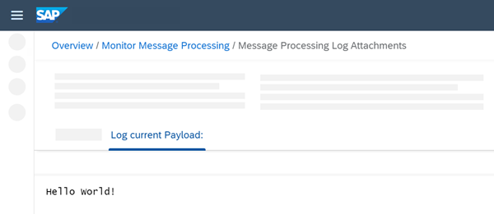
When the integration flow has been deployed successfully, the message is processed without any further trigger (based on the settings of the timer).
Go to the Operations view and select a tile under Monitor Message Processing.
If your integration flow has been processed successfully, the status Completed should be shown.
Select the integration flow and analyze the details area to the right of the integration flow list.
Under Attachments, click Log current Payload.
You should see the message content, which consists of the following text:
Hello World!

Slide 30
Smoke Test Scenario with External Data Source
This is a very simple test to verify that your SAP Cloud Integration is working as expected. You do not need any receiver system to perform this test.
In this scenario, you access an OData API and get information about a product (for a specific product ID). The result is written into the message processing log which you can directly inspect with the message monitoring application.

Slide 31
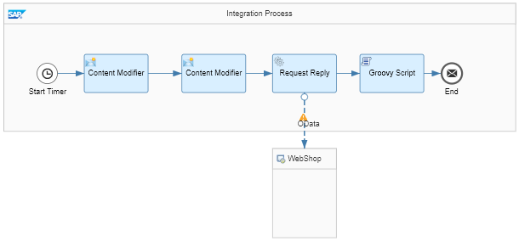
In the course of this exercise, you develop the following integration flow.

Slide 32
To make it as easy as possible for you to develop this first integration flow, you don't need to configure any sender system. That saves the effort for you to set up a dedicated sender system and to connect it to SAP Cloud Integration. Instead of this, message processing is triggered by a Timer event, and the inbound message payload is created within the integration flow, in a dedicated Content Modifier step.

Slide 33
This is how the integration flow will process the message at runtime:
The Timer event triggers the processing of the message (according to the settings of the Timer's scheduler).
The first Content Modifier step creates a message with only one element, a productIdentifier (to identify a product from the product catalog).
The actual value of the productIdentifier is hard-coded in this step. If you like to process the integration flow with another product identifier, you need to change the value in this step and re-deploy the integration flow again. This is the drawback which results from abstaining from a dedicated sender system.
The second Content Modifier creates a message header (which we also call productIdentifier) and writes the actual value of the productIdentifier element into it. This header will be used in the subsequent step.
The Request Reply step passes over the message to an external data source and retrieves data (about products) from there.
The external data source is represented by the lower WebShop shape.
The external data source supports the Open DataProtocol (OData). For our scenario, we use the ESPM WebShop, which is based on the Enterprise Sales and Procurement Model (ESPM) provided by SAP.
For the connection to the WebShop, an OData receiver channel is used. To query for exactly one product (for the product identifier provided with the inbound message), the header that has been created in the preceding Content Modifier is used.
The OData API provides the details of one specific product (according to the product identifier provided with the inbound message).
The Groovy Script step logs the payload of the message (that means, it writes the message content into the message processing log).
You can then run the integration flow and monitor message processing as described under:

Slide 34
Create a Content Modifier to Define the Message Body
Add a Content Modifier step to create the message body.
As the integration flow has no sender, we use a Content Modifier to create a message from scratch.
To add a Content Modifier, go to the palette, choose the Message Transformers icon, and select the Content Modifier icon.

Slide 35
Place the Content Modifier in the model after the Timer Start event.
In the Content Modifier properties section, go to the Message Body tab and enter the following string sequence in the entry field:
Sample Code
<root> <productIdentifier>HT-1080</productIdentifier> </root>

Slide 36
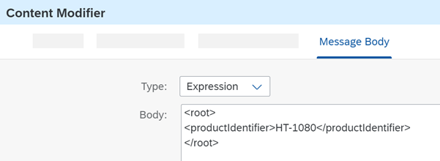
This simulates the inbound XML message.

Slide 37
Connect the Timer event with the Content Modifier. To do this, select the Timer event, click the arrow icon, and drag and drop the cursor to the Content Modifier.

Slide 38
Create a Content Modifier to Add a Header

Slide 39
Add a Content Modifier to your model to define a header, which will be used in a later step to filter data from the external source.
If you remember, our input message has only one field: productIdentifier. This field will contain a product identifier that we want to use to filter the results from the
WebShop application.
To make this number available to the integration framework during message processing, SAP Cloud Integration provides the option to store the value of productIde
ntifier from the incoming message either in the message header or in a data container referred to as an exchange property.
We use the first option, and to prepare the message accordingly we use a Content Modifier.
Add a second Content Modifier (after the first one) to the integration flow model.
In the properties section of the second Content Modifier, go to the Message Header tab and choose Add.
Specify the following parameters:
Name: Enter any name, for example, productIdentifier. This is the name of the header that will be created by the Content Modifier step.
Type: Select XPath.

Slide 40

Data Type: Enter java.lang.String.
Value: Enter //productIdentifier (which is the XPath expression that points to the productIdentifier field in the inbound message)

Slide 41
Create the Outbound OData Channel
Connect the first Content Modifier (which defines the message body) with the second one.

Slide 42
To call the external data source, add a Request Reply step to the integration flow model and connect this step with the external system using an OData channel.
o configure SAP Cloud Integration to send a request message to the external OData API (to retrieve the required data), you need to do the following:
Create a Request Reply step.
Connect the Request Reply step to a Receiver shape and select the OData adapter type.
Configure the OData adapter to specify how the OData API of the external service should be called (to define query options, for example).

Slide 43
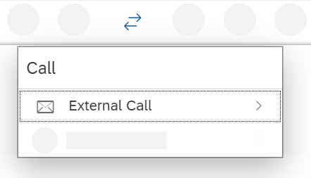
Go to the palette and select the Call entry.

Slide 44
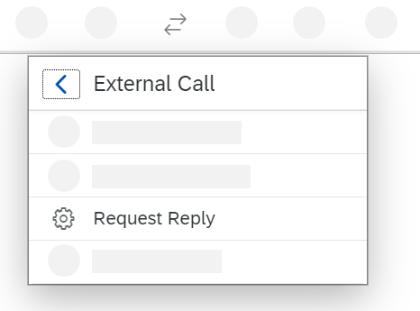
Select External Call and in the submenu choose Request Reply.

Slide 45
Place the Request Reply shape between the second Content Modifier and the End event in the model.
Furthermore, connect the second Content Modifier with the Request Reply step and the Request Reply step with the End event.
Move the Receiver shape closer to the Request Reply shape (below the Request Reply shape but outside the Integration Process shape, as shown in the overall integration flow model under Smoke Test Scenario with External Data Source).
Connect the Request Reply shape to the Receiver shape (by selecting the Request Reply shape, clicking the arrow icon, and dragging and dropping the cursor on the Receiver shape).
In the next dialog, choose adapter type OData OData V2.
In the next dialog, as Message Protocol select OData V2.

Slide 46
Go to the Connection tab of the OData adapter and enter the following as Address:
https://refapp-espm-ui-cf.cfapps.eu10.hana.ondemand.com/espm-cloud-web/espm.svc

Slide 47
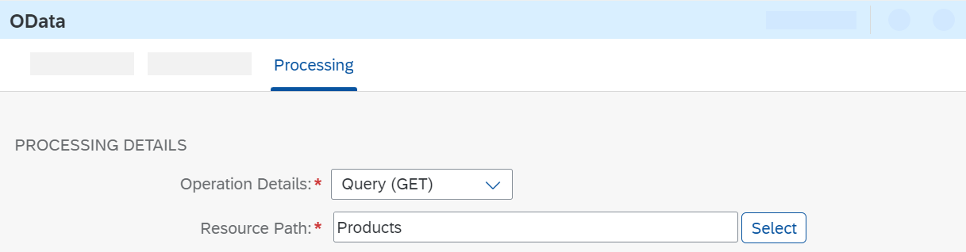
Go to the Connection tab of the OData adapter and enter the following as Address:
https://refapp-espm-ui-cf.cfapps.eu10.hana.ondemand.com/espm-cloud-web/espm.svc
Go to the Processing tab.
Next to Resource Path, choose Select.

Slide 48
In the Query Editor opens, you can conveniently define the OData query.
The Address field is already populated with the value you just entered.
Make sure that Remote is selected as the Connection Source, and choose Step 2.
The system connects to the WebShop service and retrieves the metadata from its OData API.
Choose the search icon in the Select Entity field.

Slide 49
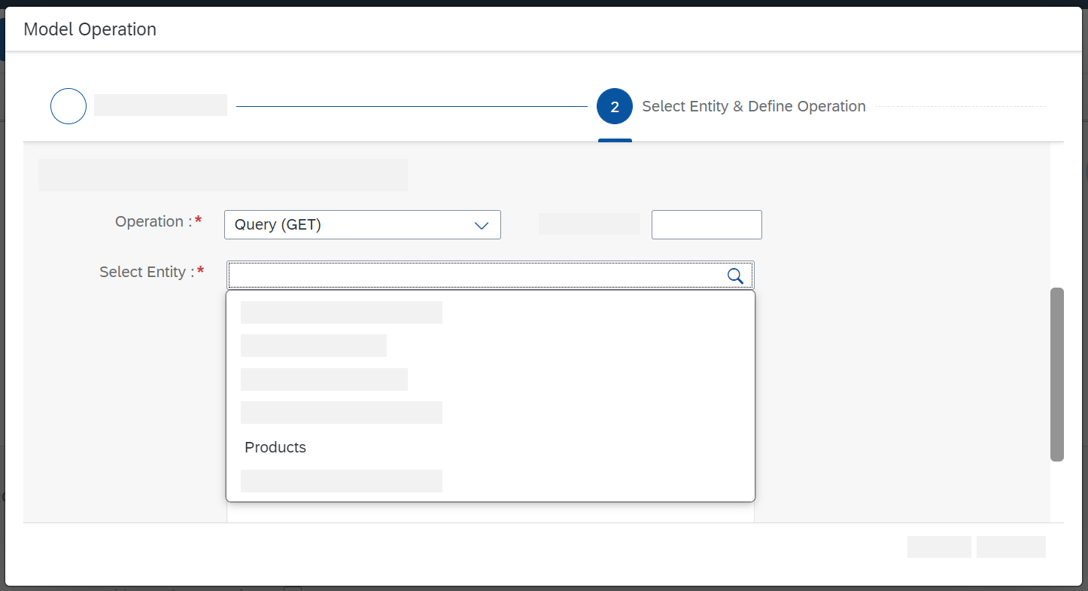

Slide 50
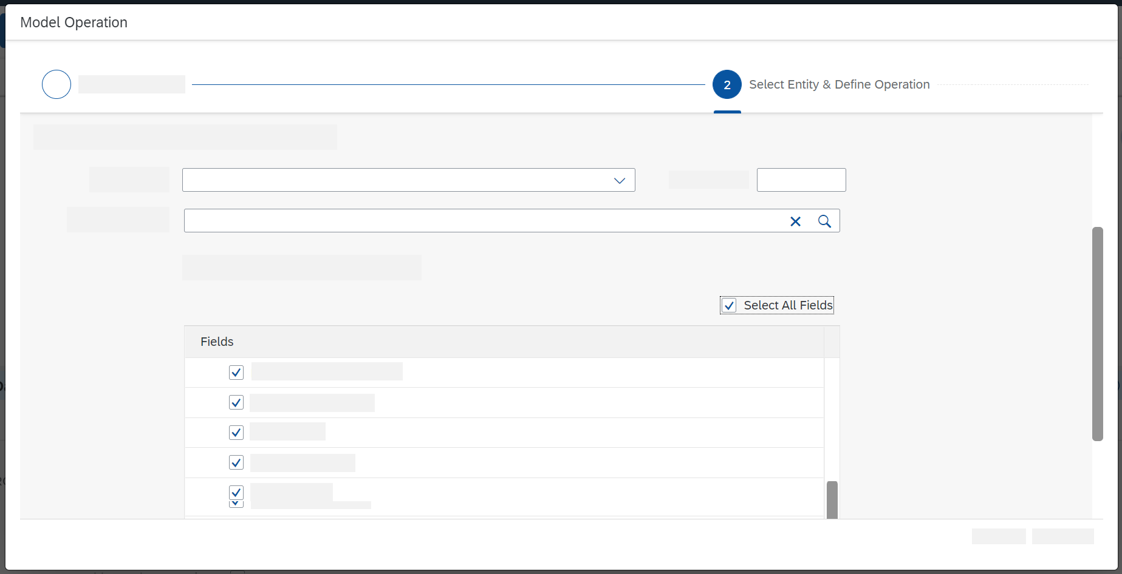
Select Products.
A list of the available elements is provided, using the information from the OData API.
Choose a set of elements for which you want to retrieve data (for example, all elements, as shown in the next figure) and choose Step 3.

Slide 51
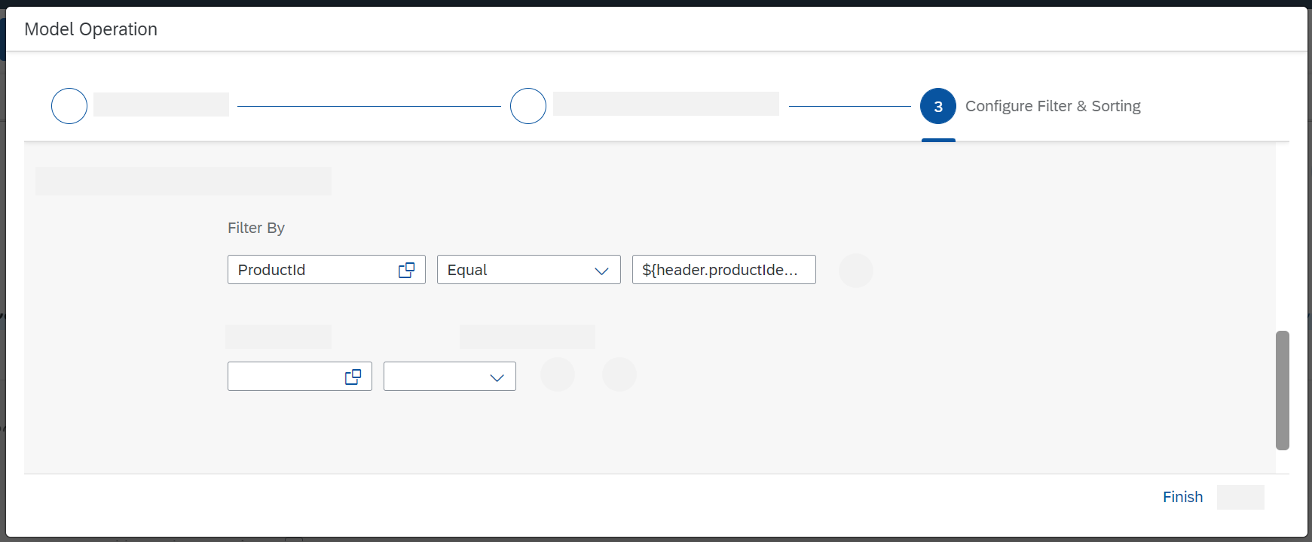
Choose the copy icon in the Filter By field and select ProductId.
Select Equal.
In the third field, enter an expression that allows the integration framework to access the message header productIdentifier that you created in the preceding Content Modifier step: ${header.productIdentifier}.

Slide 52
Create the Script Step to Log the Payload
Add a Script step to log the message payload.
With a Groovy Script step, you can configure the integration in such a way that the payload of the message is written to the message processing log.
To add a Script step (containing a Groovy script), go to the palette and choose the Message Transformers icon and select the Script icon.

Slide 53
In the Script submenu, select Groovy Script.

Slide 54
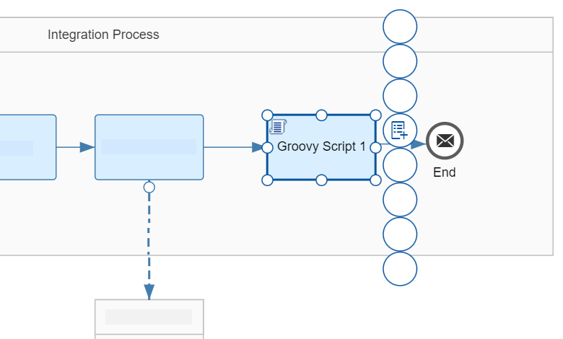
Place the Script Step shape after the Request Reply step and connect both shapes.
Select the Script step.
The context icons are displayed.

Slide 55
Choose the + icon.
The default script coding of the step is displayed.

Slide 56
import com.sap.gateway.ip.core.customdev.util.Message;
import java.util.HashMap;
def Message processData(Message message)
{
def body = message.getBody(java.lang.String) as String;
def messageLog = messageLogFactory.getMessageLog(message);
if(messageLog != null)
{
messageLog.addAttachmentAsString("Log current Payload:", body, "text/plain");
}
return message;
}

Slide 57
hoose OK.
The integration flow model is again displayed.
Save and deploy the integration flow.

Slide 58
Content Modifier
You use the content modifier step to modify the content of incoming message by providing additional information in the header or body of the message.

Slide 59
The Content Modifier allows you to modify a message by changing the content of the data containers that are involved
in message processing (message header, message body, or message exchange). Depending on which container you want to modify
, select one of the tabs Message Header, Message Body, or Exchange Property. If modifying the Message Body, you can enter
the data you want to add to the message body in an editor. If modifying the Message Header or the Exchange Property,
you can define how to access the content of the incoming message (which is then used to change the selected data container).
For example, in the Source Type, select XPath to specify an XPath expression
that addresses a particular element in the incoming message, which will be used to change the message header

Slide 60
Procedure
If the Content Modifier step is present in the integration flow, select it to edit the properties.
If you want to add Content Modifier step to the integration flow, perform the following substeps:
In the palette, choose  (Message Transformers)and then choose  (Content Modifier).
Place Content Modifier step in the integration process.
Go to the Message Header tab or choose Exchange Property (depending on whether you want to modify a message header or write data to the exchange property).

Slide 61
Choose Add to define a new entry.
Specify and define the parameters of the entry as shown below

Slide 62
Content Modifier Attributes for Message Header or Exchange Property
Attribute | Description
Action | You can specify whether the Content Modifier should create or delete the header or property defined by the table row. You must specify the name of the header or property you want to delete.
Name | Name under which the specified data has to be stored in the selected header or property data container.
Source Type | Indicates the kind of data you want to use to change the content of the selected header or property data container. You can select from the following types: Constant Allows you to write a constant value to the header or property data container. Special characters like {} and [] are not allowed. Header Allows you to specify the name of a Camel header. You can then use this header to dynamically define properties in subsequent steps. For example, if you specify the header name CamelSplitIndex, the Camel header of the same name, which counts the actual number of splits in a message split scenario, is accessed from the incoming message. In a subsequent step, you use the following expression to refer to this header (for dynamic configuration): ${header.CamelSplitIndex}. To enter a header, select header in the Type column and in the Value column choose Select to browse for predefined headers.

Slide 63
Source Type | Indicates the kind of data you want to use to change the content of the selected header or property data container. You can select from the following types: Constant Allows you to write a constant value to the header or property data container. Special characters like {} and [] are not allowed. Header Allows you to specify the name of a Camel header. You can then use this header to dynamically define properties in subsequent steps. For example, if you specify the header name CamelSplitIndex, the Camel header of the same name, which counts the actual number of splits in a message split scenario, is accessed from the incoming message. In a subsequent step, you use the following expression to refer to this header (for dynamic configuration): ${header.CamelSplitIndex}. To enter a header, select header in the Type column and in the Value column choose Select to browse for predefined headers.

Slide 64
XPath
Allows you to retrieve data from the incoming message using XML Path Language (XPath). For example, if you have selected this type, you can specify the following Value to point to an element customerName in the incoming message: /Order/Customer/CustomerNumber.
To enter XPath, select XPath in the Type column and in the Value column choose Select to browse for predefined xpath listed in wsdl of SOAP adapter for the sender.

Slide 65
Expression
Allows you to enter a Camel Simple Expression Language expression (see http://camel.apache.org/simple.htmlInformation published on non-SAP site).
For example, you can use the expression ${exchangeId} to add the exchange ID (a unique identifier of the message exchange) to a data container.
For more information on using Simple Expression Language, see Using Camel Simple Expression Language.
Property
Allows you to specify an exchange property.
To enter a property, select property in the Type column and define a value based on the selected value type

Slide 66
External Parameter
This option is not available in WebUI but for compatibility reasons we still support content using this field.
Integration developer can use externalization and externalize any type of headers or exchange properties.
Please refer to Externalize Parameters of an Integration Flow for more details.
Local Variable
Allows you to define a local variable and write its value at runtime to the header or property data container. The value can then be evaluated in subsequent steps of the integration flow.

Slide 67
Number Range
Allows you to retrieve the value (a unique identifier) of a predefined number range.
Example
If you want to increase the value in the message header define the name of the Number Range.
If you do not want to increase the value in the message header, then define the value as <name of the Number Range>:${header.headername} or <name of the Number Range>:<correlation ID>.
Note
Make sure you use the same correlation ID for all future processing.
For more information on adding number range, see Managing Number Ranges.
Global Variable
Allows you to define a global variable and to write its value at runtime to the header or property data container.
A global variable can be used across different integration flows of the same tenant.

Slide 68
Source Value | Value of the property
Data Type | Valid Java data type The Data Type column is used only for the types XPath and Expression. The data type can belong to any Java class. For example, if you are addressing a string-type element, enter java.lang.String as the Java data type. For more information about supported data types, see https://camel.apache.org/components/latest/languages/simple-language.html. If the XPath contains a namespace prefix, specify the association between the namespace and the prefix on the Runtime Configuration tab page of the integration flow Properties view. To enter an XPath, select XPath in the Type column and browse for an XPath from the lookup in the Value column.

Slide 69
Default Value (Only relevant if you have selected Local Variable or Global Variable as Type) | If you have selected Local Variable or Global Variable as Type, the value specified as Default will be assigned to the header

Slide 70
Go to the Message Body tab, and define the fields as shown below.
Save or deploy the changes.
Note
If you add a Content Modifier step without a header, body, and property, you cannot trace the element.
The Data Type column is used for the XPath type. The data type can belong to any Java class. An example of a data type for an XPath is java.lang.String.
Example
Let us assume that the incoming message contains the following information content:
<product> <productId>HT-1051</productId> <productName>Deskjet Mobile</productName> </product>
Attribute | Description
Type | The default value is Expression. If the payload contains expressions within it, then set the type as Expression; if the payload is huge and it has no expressions within it, then it is recommended to use the type Constant.
Body | Enter the content expected in the outgoing message.Remember Ensure that you set a placeholder for the existing header information.

Slide 71
Parameter | Value
Name | timestamp
Type | Expression
Data Type | java.lang.String
Value | ${date:now:yyyy-MM-dd HH:mm:ss}
The message contains information about an individual product from a product catalog.
The use case is that this message is to be enriched with the actual system time (as order time) and transferred into an order message.
In a first content modifier, specify the following settings in the Exchange Property tab:
Using the expression ${date:now:yyyy-MM-dd HH:mm:ss}, at runtime the actual system time is retrieved from the system.
The content modifier stores the time value in the timestamp property.
In a 2nd content modifier, enter the following expression in the Message Body tab:
<order> <time>${property.timestamp}</time> ${in.body} </order>

Slide 72
At runtime, the expression ${property.timestamp} dynamically retrieves the timestamp stored in the previous content modifier.
The expression ${in.body} is replaced by the actual content of the inbound message.
As a result, the final message (after the 2 content modifiers) has the following content for our example:
<order> <time>2021-05-19 09:20:56</time> <product> <productId>HT-1051</productId> <productName>Deskjet Mobile</productName> </product> </order>

Slide 73
Content Modifier Basics
To interpret an integration flow model at runtime, it is transformed into an XML structure that is compatible with Apache Camel (http://camel.apache.orgInformation published on non-SAP site), an Open Source integration framework for Java that supports the mediation and routing of messages of any format.
The only prerequisite for a message that is to be processed by the Camel framework is that it comprises the following elements:
Headers
Contain information related to the message, for example, information for addressing the message sender.
Attachments
Contain optional data that is to be attached to the message.
Body
Contains the payload (usually with the business-related data) to be transferred in the message..

Slide 74
You can use the Content Modifier step to modify a message by adding additional data to it.
More precisely, this step type allows you to modify the content of the following three data containers during message processing:
Message Header
You can add headers to the message, and edit and delete headers.
Message Body
You can modify the message body part.
Exchange Property
You can write data to the message exchange, and edit and delete the properties.

Slide 75
Example
The following example shows how to modify both the header and body data container of a message using the Content Modifier step.
Suppose that the incoming message has the following information:
<order> <book> <BookID>A1000</BookID> <Count>5</Count> </book> </order>
On the Message Header tab of the Content Modifier, enter the following to write constant values to the message header:
Action | Name | Source Type | Source Value
Create | vendor | constant | ABC Corp
Create | delivery date | constant | 25062013

Slide 76
On the Body tab, keep placeholders for the header information specified in the first Content Modifier step (${header.vendor} and ${header.date}) to modify the content as shown below. Additionally, use a placeholder ${in.body} for the incoming message.
<invoice>
<vendor>${header.vendor}</vendor>
${in.body}
<deliverydate>${header.delivery date}</delivery>
</invoice>

Slide 77
The output message would look like this:
<invoice>
<vendor>ABC Corp</vendor>
<order>
<book>
<BookID>A1000</BookID>
<Count>5</Count>
</book>
</order>
<deliverydate>25062013</deliverydate>
</invoice>

Slide 78
Simple Expression | Output Value
${date:now:yyyyMMdd’T’hh:mm:ss} | 20211201T03:34:48
${date:now:yyyyMMdd} | 20211201
${date:now:yyyyMMdd HH:mm:ss} | 20211201 15:34:48
${date:now:yyyyMMdd HH:mm:ss.Sz} | 20211201 15:34:48.54UTC
${date:now:yyyyMMdd’T’HH:mm:ss.SSS Z} | 20211201T15:34:48.054 +0000
${date:now:yyyyMMdd HH:mm:ss.SSS aaa} | 20211201 15:34:48.054 PM

